Slide 1
CAPSTONE PROJECT: Analytical CRM Development for a Bank
SHAIK KHWAJA MOHIDDIN
Newtons school
Batch- Oct 2023

Slide 2
CONTENTS
01
02
03
04
05
06
Introduction
Overview
Problem statement
Churn analysis Report & Insights
Conclusion
Dashboard

Slide 3
01.INTRODUCTION
Database
Firstly, creating database in MySQL Workbench and
Converted the given excel datasets to csv format and imported into database and implemented the queries based on the given questions.
Data Optimisation
And I connected the SQL server to Power BI and utilized Power query editor for if there any data inconsistency, seems to be data is cleaned.
In Power BI added custom columns for better visualization of data like Credit buckets, Age buckets, Z-score, Outliers and Utilized DAX formula to get the Churn rate.

Slide 4
02.OVERVIEW
In this presentation, we'll explore bank churn and demographic reports to gain insights into why customers leave banks and how various factors such as credit card usage, account activity, credit scores, and age impact bank performance. Additionally, we'll discuss the challenges we encounter and propose solutions to address them.

Slide 5
03.PROBLEM STATEMENT
As an analytical CRM for a bank, I've been tasked with extracting valuable insights from a variety of customer-related datasets. Our Aim is to reduce customer churn, enhance service delivery, and ultimately improve customer satisfaction.

Slide 6
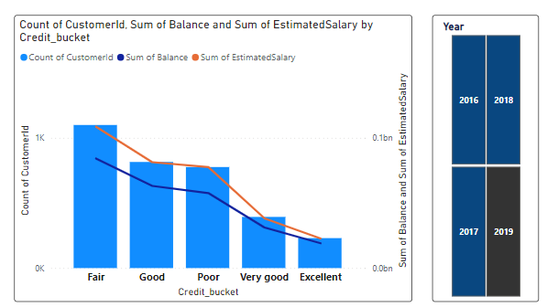
04.CHURN ANALYSIS REPORT
Customer Behaviour Analysis :
The distribution of Total Customers across different Credit Score buckets, revealing intriguing patterns and correlations. The highest number of customers are found in the Fair, Good, and Poor credit score segments and Very Good and Excellent segments has low number of customers.

Slide 7
Customer Behaviour Analysis :
Utilizing the slicer for a year-by-year analysis of the relationships among these variables, this phenomenon suggests that individuals with higher credit scores tend to manage their finances more prudently.
For other segments we notice significant gaps between the amounts in their balances and their salaries, implying the presence of potentially detrimental spending behaviours these habits likely contribute to their lower credit scores.

Slide 8
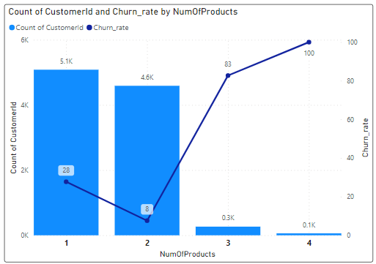
Product Affinity Study:
The maximum customers use 1 and 2 products. No. of customers using 3 and 4 products are less comparatively. The churn rates of customers using 3 and 4 products are also high with 83% and 100% respectively.

Slide 9
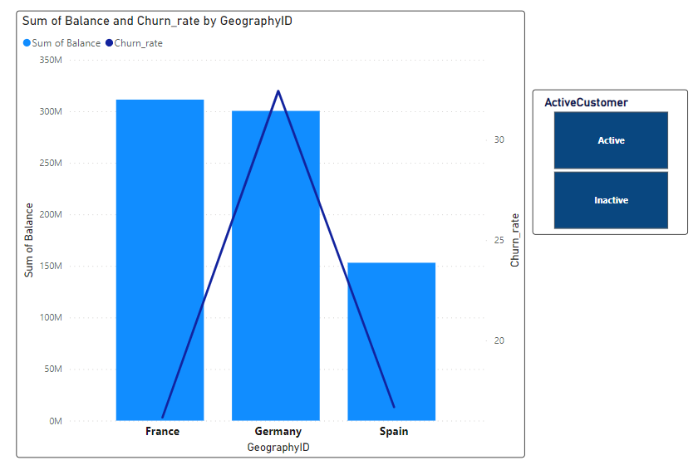
Geographic Market Trends:
In terms of account balances, France and Germany are leading, while Spain is lagging behind.
While comparing churn rates, I found out that churn rates are significantly higher in Germany for Inactive customers.
This can be a key indicator for risk and should be treated with priority

Slide 10
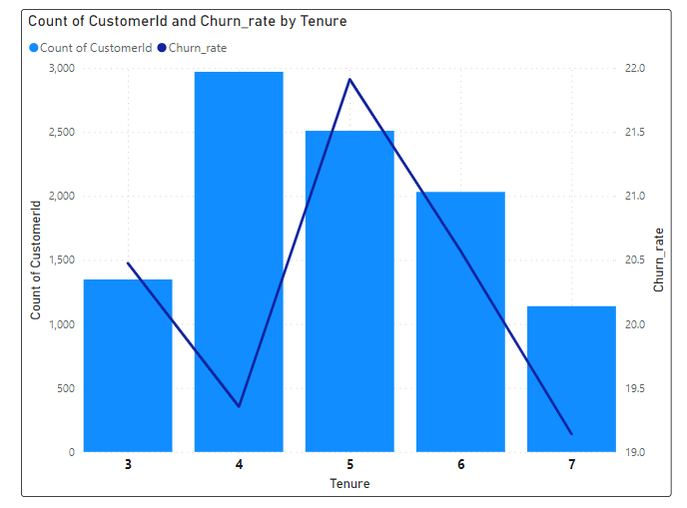
Risk Management Assessment:
The churn rates decline from the 3 to 4 tenures.
Also, we observe that the churn rate rises again in tenure 5, and that this decline continues as tenure grows.
This suggests that customer will remain with the bank for 4 to 5 years, after which they might leave.
This indicates a high risk for the bank because there is a good probability the customer will leave once their five-year tenure is over.

Slide 11
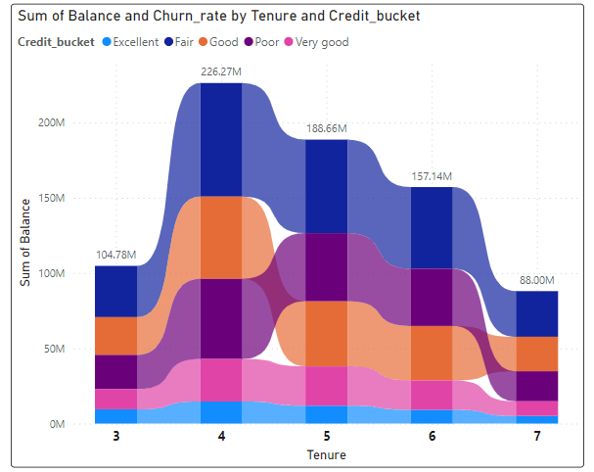
Customer Lifetime Value Forecast:
The largest balance is found in the Fair Segment of customers when we look at the balance distribution across all of the credit card segments.
The Excellent and Very Good segments have the least amount of balance.
There are noticeable balances in Poor segment as well.
As we see other tenures, this pattern continues.

Slide 12
Marketing Campaign Effectiveness
To assess the impact of marketing campaigns on customer retention and acquisition within the dataset, we can measure changes in customer activity status and acquisition rates over time, comparing periods before and after the campaigns.
Establish a system for continuous monitoring and evaluation of marketing campaign effectiveness. Iterate and refine analysis based on new data and insights gained over time.

Slide 13
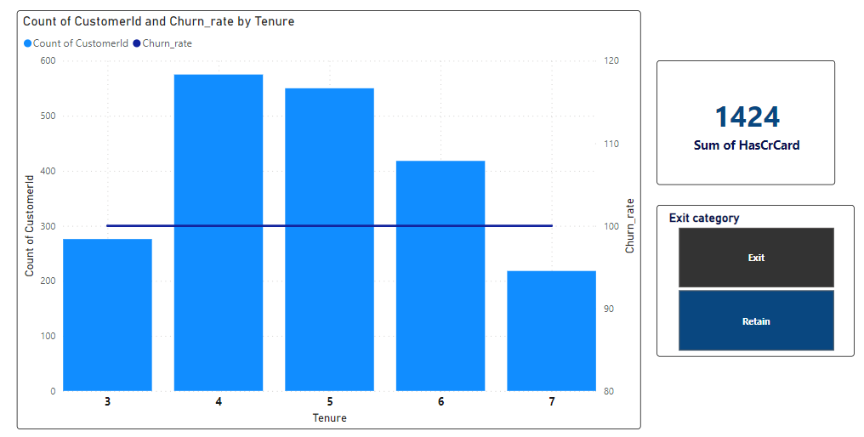
Customer Exit Reasons Exploration
About 1424 of the 7055 customers that left having credit cards, out of the total number of credit card holders. This demonstrates that customers without credit cards are leaving the bank.
As tenure increases, we observe customers leaving the bank. This indicates that we are unable to keep customers for longer periods of time.

Slide 14
Key Insights & Recommendations
Customers with Low Credit Scores and Small Tenures:
Customers categorized as 'Poor' or 'Fair' in credit score, along with those with smaller tenures, are at higher risk of leaving the bank.
To address this, targeted retention strategies and personalized offers could be implemented to improve customer satisfaction and loyalty.
Usage of Products:
Most customers are only using 1 or 2 products, indicating potential opportunities for cross-selling or upselling additional products or services.
By offering tailored product bundles or incentives, you can encourage customers to explore more of your offerings, thus increasing their engagement and potentially reducing churn.

Slide 15
Geographical Focus:
While France contributes the most to our business, there is a noticeable lag in Germany and Spain. Given the higher churn rates in Germany, it's crucial to prioritize efforts in this region. This could involve analyzing the reasons behind the higher churn rates
Implementing targeted retention strategies specific to the German market.
Age Segments:
There are fewer customers in the young adults and old age adults segments, with the majority falling within the middle age adults segment. However, focusing on young adults could be beneficial, as they have the potential for longer tenures with the bank.
Tailored marketing campaigns and product offerings aimed at this demographic could help attract and retain younger customers.

Slide 16
05.Conclusion
To succeed in the market, it's crucial to address issues such as
High churn rates
Low products utilization and
Target specific customer segments effectively.
By focusing efforts on increasing
Customer engagement
Targeting young adults and Implementing a segmented approach based on credit scores
Business can enhance competitiveness and drive growth in both existing and new markets.

Slide 17
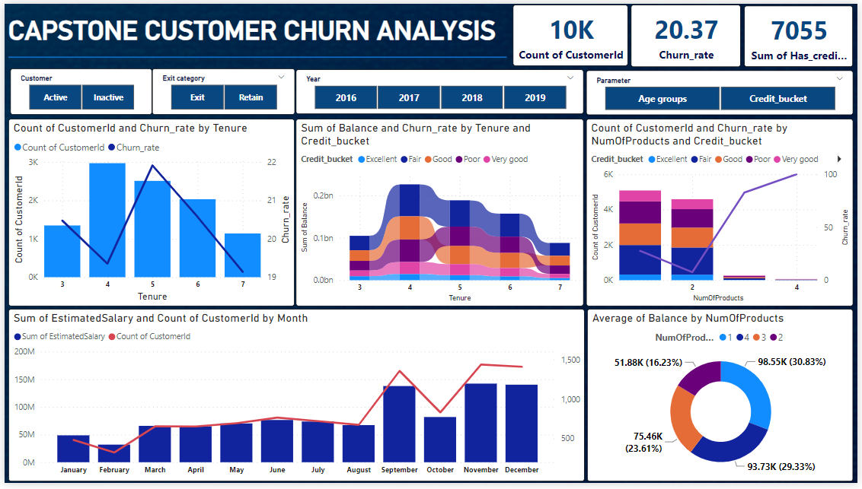
06.Dashboard

Slide 18
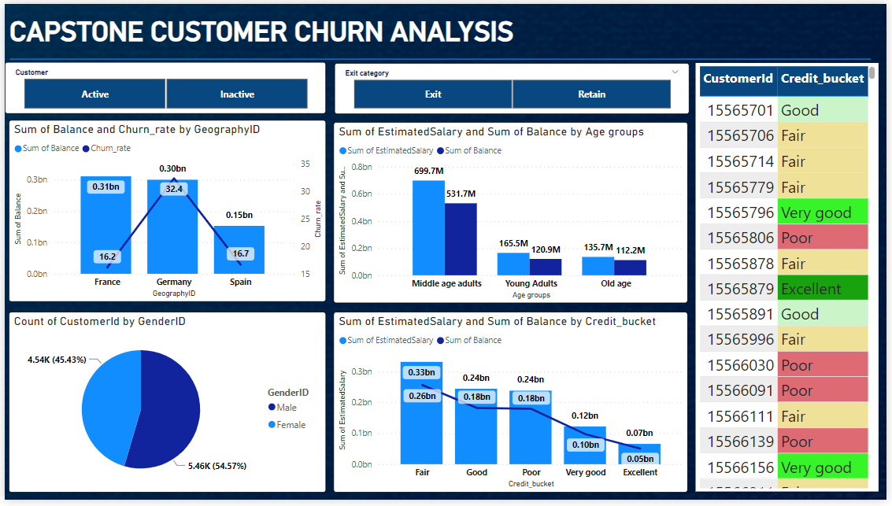
Demographics

Slide 19
Thanks!
Do you have any questions?
khwajamohiddin1999@gmail.com

